Slide 1
A Style-Based Generator Architecture for Generative Adversarial Networks - paper published by NVIDIA and project proposed by Ian Goodfellow in 2014
Mohammed khadeeruddin vemana vijay kumar

Slide 2
Overview
Quick introduction to GANs
GAN Objective function
GAN techniques
Progressive Growing
Style GAN
Style GAN Model Architecture
Playing with latent space of Style GAN (Project Execution)

Slide 3
WHAT IS GAN?
A generative adversarial network (GAN) is a type of machine learning technique made up of two neural networks.
The two neural networks that make up a GAN are:
a GENERATOR with a goal to generate new instances of an object that will be indistinguishable from the real ones, and
a DISCRIMINATOR that takes samples from both the training data and the generator’s output and predicts if they are “real” or “fake”.
GANs can be used to create all types of content including images, video, text, audio.

Slide 4
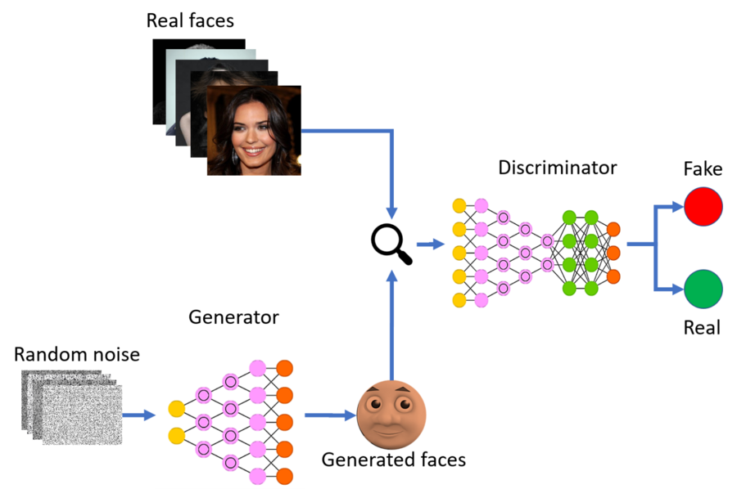

Slide 5
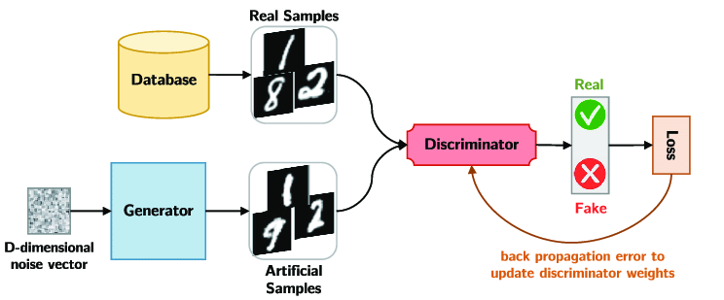

Slide 6
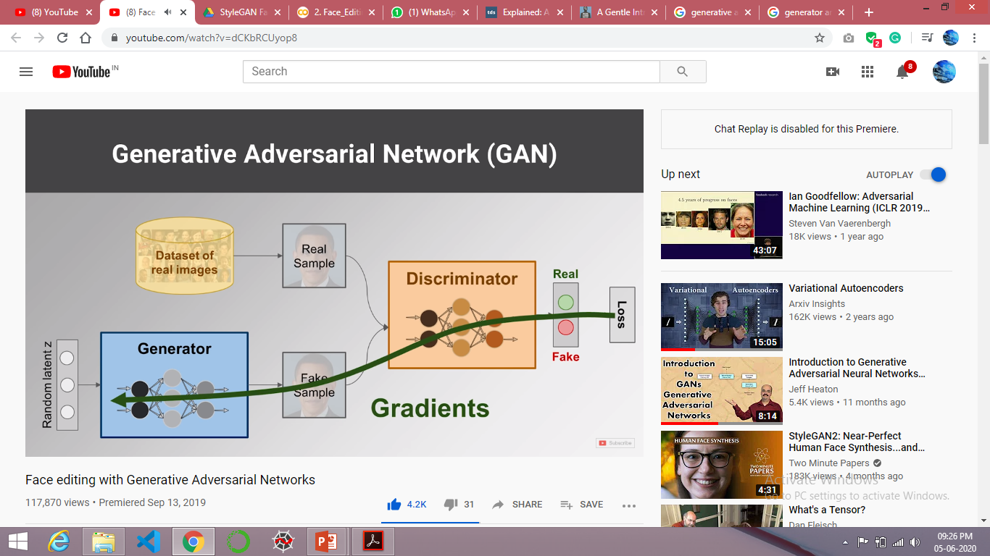
Discriminator loss is passed to Generator as an objective function.

Slide 7
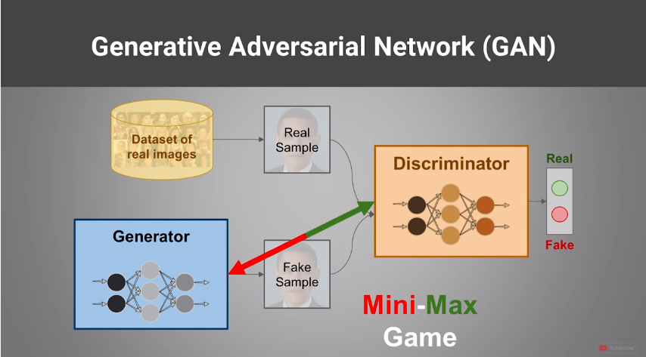

Slide 8
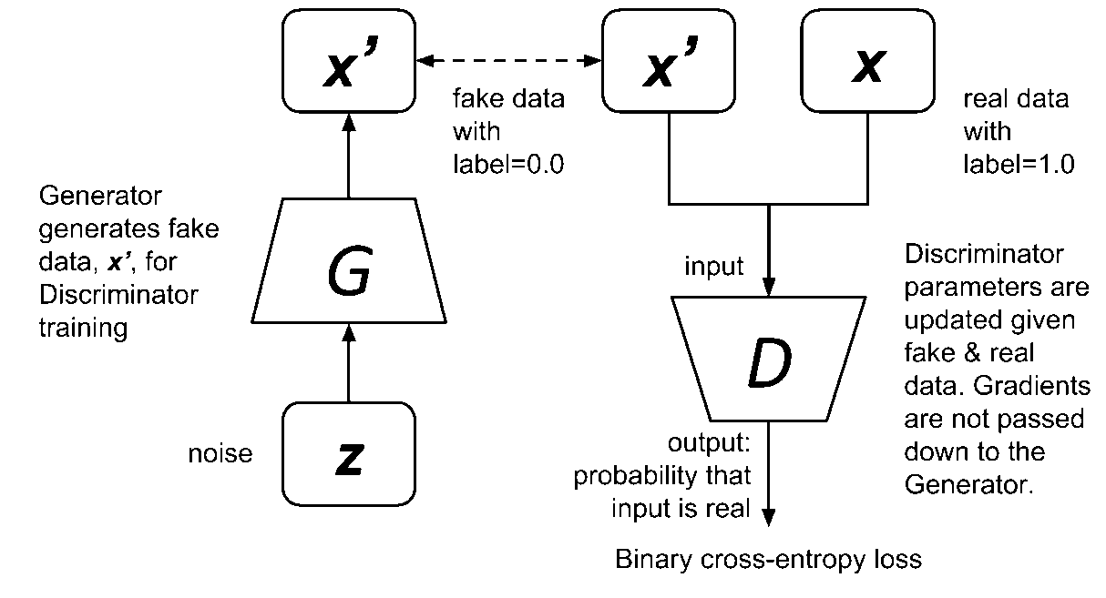

Slide 9
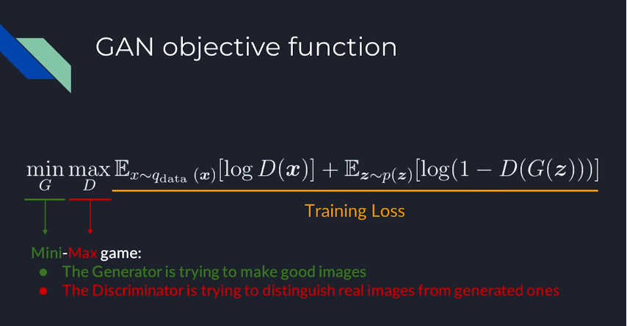

Slide 10
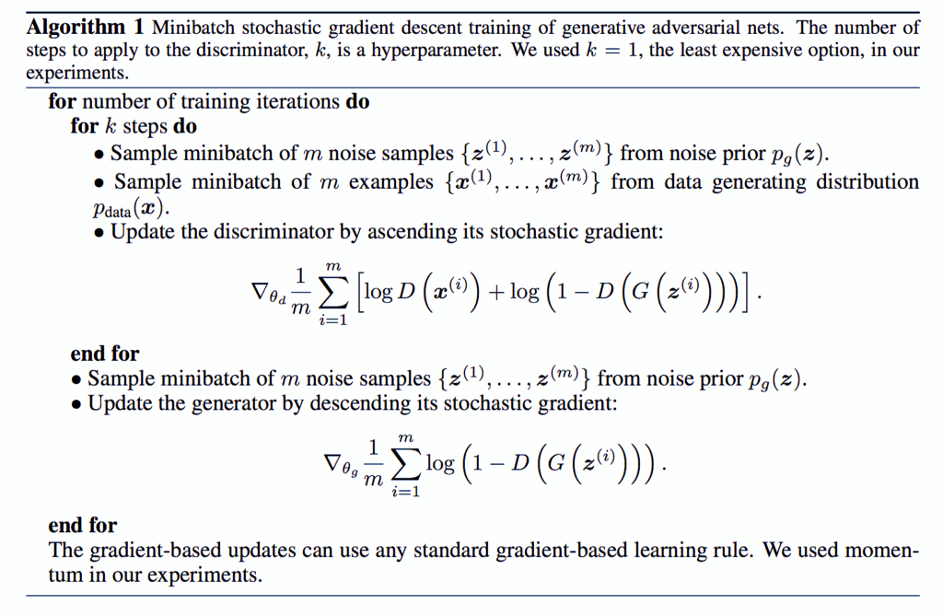

Slide 11
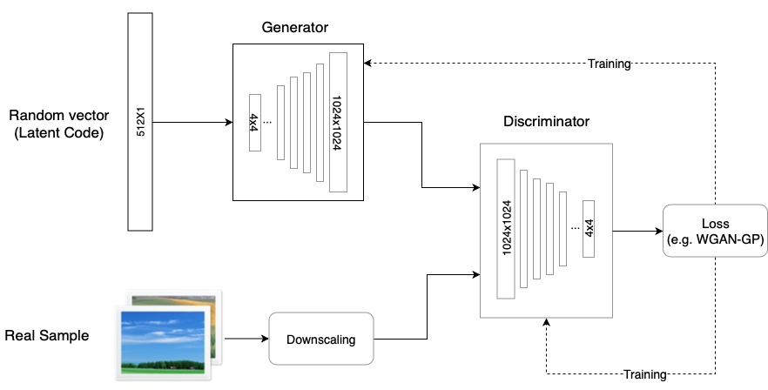
GAN techniques Progressive Gans It starts by training the generator and the discriminator with a very low-resolution image (e.g. 4×4) and adds a higher resolution layer every time.

Slide 12
Progressive Gans
The StyleGAN generator and discriminator models are trained using the progressive growing GAN training method.
This means that both models start with small images, in this case, 4×4 images. The models are fit until stable, then both discriminator and generator are expanded to double the width and height (quadruple the area), e.g. 8×8.
A new block is added to each model to support the larger image size, which is faded in slowly over training. Once faded-in, the models are again trained until reasonably stable and the process is repeated with ever-larger image sizes until the desired target image size is met, such as 1024×1024.

Slide 13
How StyleGAN works
Traditionally the latent code is provided to the generator through an input layer, Given a latent code z in the input latent space Z, a non-linear mapping network f : Z →. W first produces w ∈ W
we first map the input to an intermediate latent space W, which then controls the generator through adaptive instance normalization (AdaIN) at each convolution layer. Gaussian noise is added after each convolution.
It divides into three types:
Coarse - resolution of up to 82 - affects pose, general hair style, face shape, etc.
Middle - resolution of 162 to 322 - affects finer facial features, hair style, eyes open/closed, etc.
Fine - resolution of 642 to 10242 - affects colour scheme (eye, hair and skin) and micro features.

Slide 14
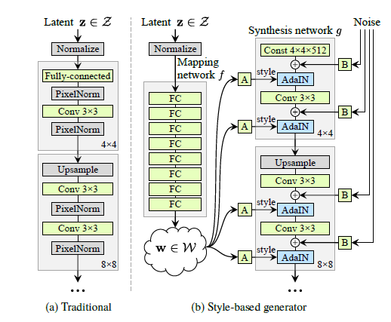
Style GAN Model Architecture

Slide 15
Style GAN Model Architecture
Most models, and ProGAN among them, use the random input to create the initial image of the generator (i.e. the input of the 4×4 level). The StyleGAN team found that the image features are controlled by ⱳ and the AdaIN, and therefore the initial input can be omitted and replaced by constant values.
Mapping Network
The Mapping Network’s goal is to encode the input vector into an intermediate vector whose different elements control different visual features. The Mapping Network consists of 8 fully connected layers and its output ⱳ is of the same size as the input layer (512×1).
The AdaIN (Adaptive Instance Normalization)
It is a module transfers the encoded information ⱳ, created by the Mapping Network, into the generated image. The module is added to each resolution level of the Synthesis Network and defines the visual expression of the features in that level.
The noise in StyleGAN is added in a similar way to the AdaIN mechanism. A scaled noise is added to each channel before the AdaIN module and changes a bit the visual expression of the features of the resolution level it operates on.

Slide 16
Style mixing
The StyleGAN generator uses the intermediate vector in each level of the synthesis network, which might cause the network to learn that levels are correlated.
To reduce the correlation, the model randomly selects two input vectors and generates the intermediate vector ⱳ for them. It then trains some of the levels with the first and switches (in a random point) to the other to train the rest of the levels.
The random switch ensures that the network won’t learn and rely on a correlation between levels. Though it doesn’t improve the model performance on all datasets, this concept has a very interesting side effect ,its ability to combine multiple images in a coherent way.
The model generates two images A and B and then combines them by taking low-level features from A and the rest of the features from B.

Slide 17
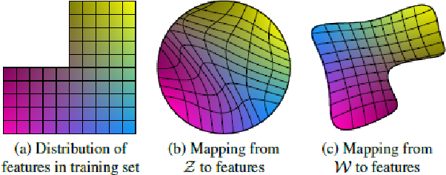

Slide 18
Conclusion
The techniques presented in Style GAN, especially the Mapping Network and the Adaptive Normalization (AdaIN), will likely be the basis for many future innovations in GANs.

Slide 19
THANK YOU

